Slide 1
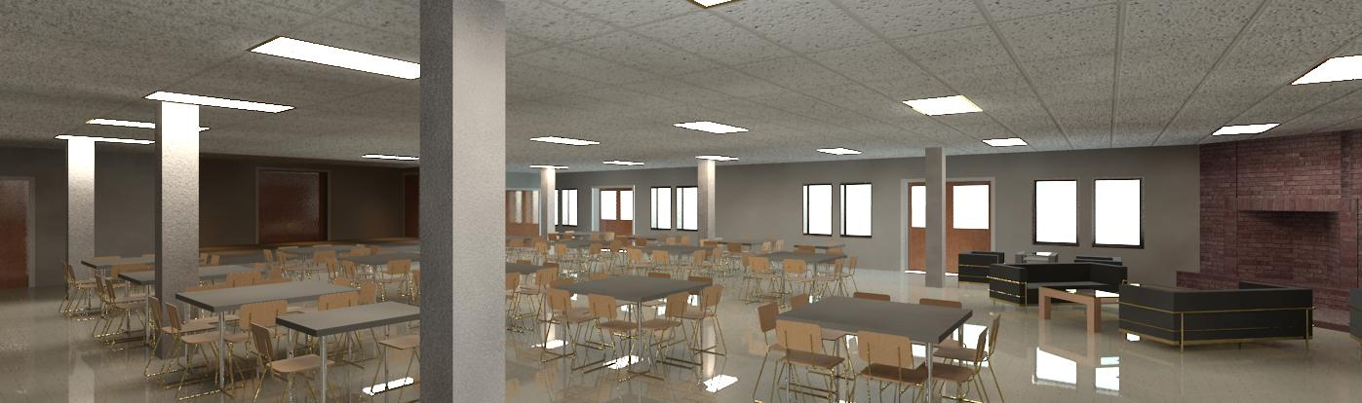
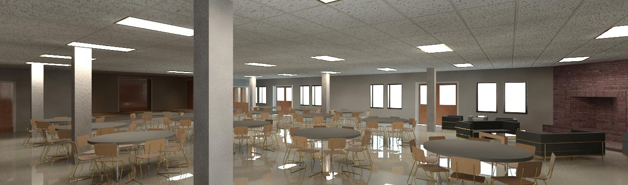
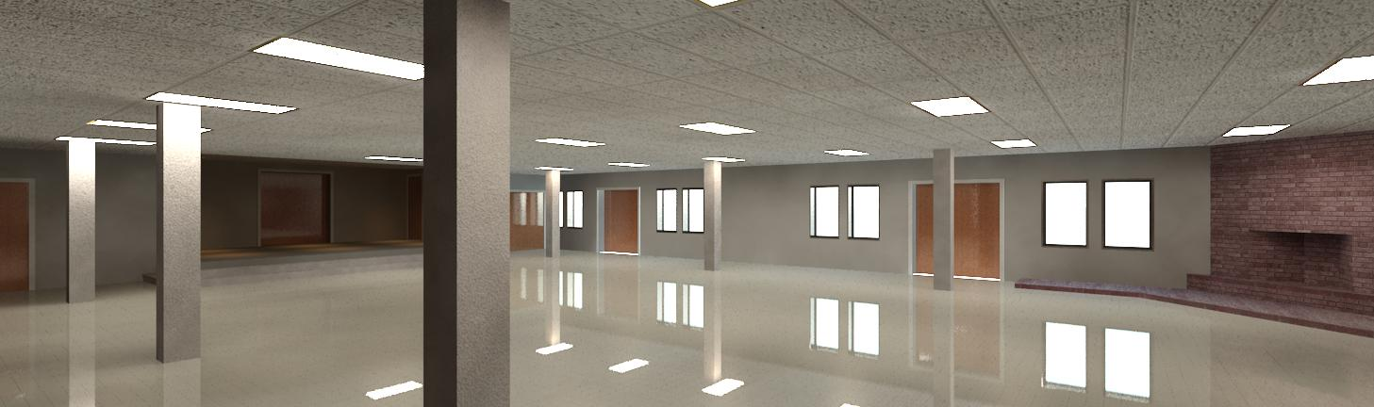
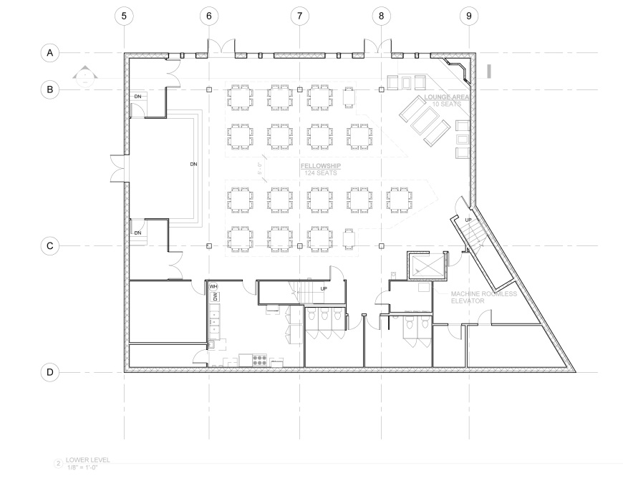
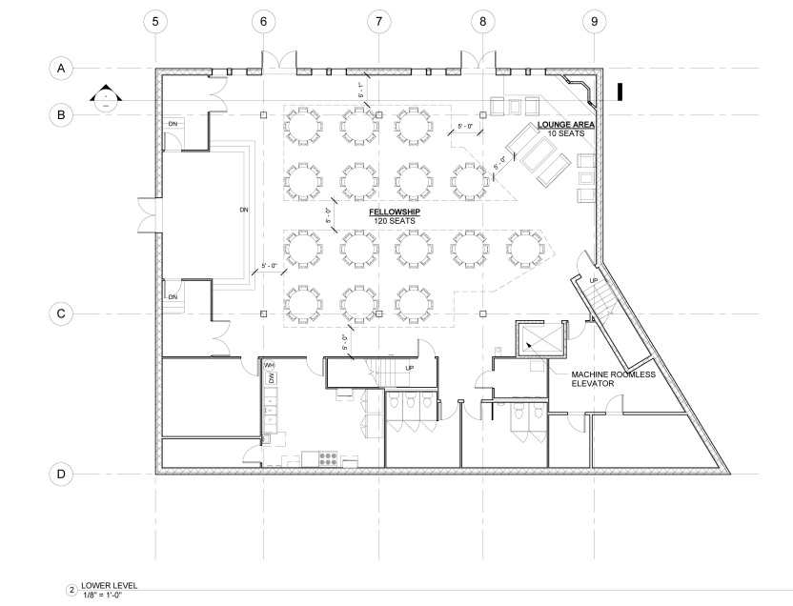
Breath of life seventh day Adventist church
Fellowship Layout : Option 2
Fellowship Layout : Option 1
FT. WASHINGTON, MARYLAND
Lower Level Fellowship Hall and Lounge Area
SEATING TABULATIONS
(15) 4’ X 4’ SQUARE TABLES
8 SEATS AT EACH 4’ X 4’TABLE
(2) 2’ X 3’ TABLES
2 SEATS AT EACH TABLE
124 TOTAL SEATS
SEATING TABULATIONS
15 TABLES 5’ ROUND
8 SEATS PER TABLE
120 TOTAL SEATS

Slide 2
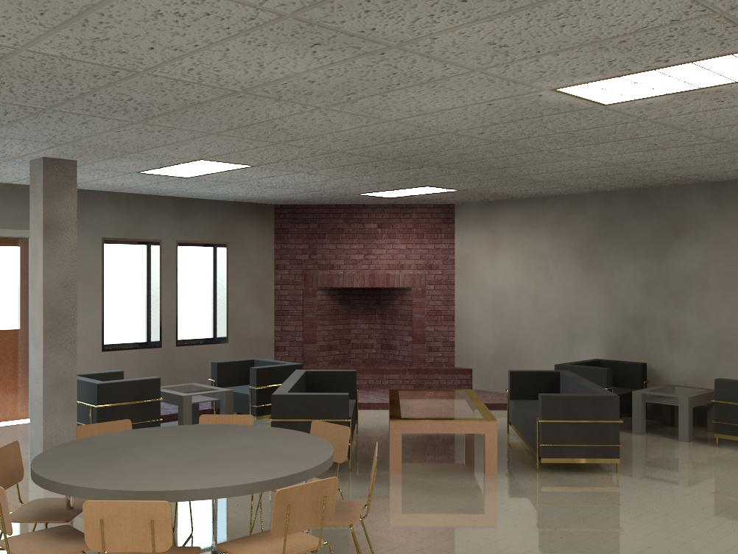
FELLOWSHIP LOUNGE AREA

Slide 3
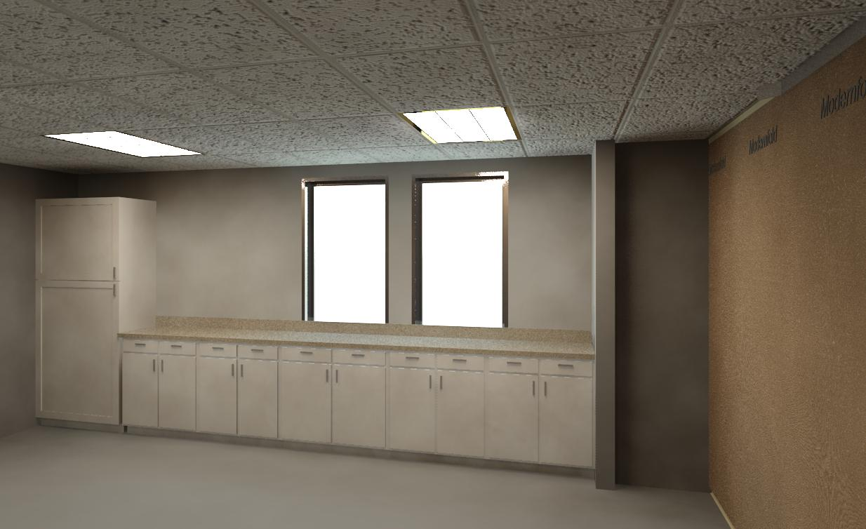
CLASSROOM MILLWORK AREA

